Slide 1
BENIGN ODONTOGENIC AND NON ODONTOGENIC TUMOURS

Slide 2
ODONTOGENIC TUMOR
An imprecise term that encompasses a wide spectrum of variants depending upon embryologic stage of initiation, histologic and gross appearance of lesion

Slide 3
Uncommon lesions that are derived from specialised dental tissues.
Primarily intraosseous lesions (central).
Occassionally occurs extraosseously (peripherally).
These tumors have varied clinical & radiographic appearance.

Slide 4
Entirely soft tissue
Mixture of soft & calcified tissues.
Entirely calcified tissues.
Wide range of biologic behaviour &b’coz of this various treatment methods have been described : from conservative to very aggressive treatment.

Slide 5
Classification based on tissue of embryonic origin & the epithelial- ectomesenchymal interactions.
A] Epithelial Origin-:
i) Tumours producing minimal inductive change in c.t
a) Ameloblastoma
b) CEOT [Pindborg Tumor]
c) Adenoameloblastoma [Odont.Adenomatoid Tumor]
ii) Tumours producing extensive inductive changes
a) Ameloblastic Fibroma
b) Ameloblastic Fibro-odontoma
c) Ameloblastic Odontoma
d) Odontoma :- Compound & Complex Composite.

Slide 6
B] Mesodermal Origin. -:
i) Central Odontogenic Fibroma
ii) Odontogenic Myxoma
iii) Dentinoma
iv) Cementoma
a. Periapical Cemental Dysplasia
b. Cementifying Fibroma
c. Benign Cementoblastoma

Slide 7
C] Tumours of unknown origin -:
i) Melanotic neuroectodermal tumor of infancy
D] Malignant Origin. -:
i) Odontogenic Carcinoma -:
a. Primary Intraosseous Ca.
b. Malignant Ameloblastoma.
ii) Odontogenic Sarcoma -:
a. Ameloblastic Fibrosarcoma.
b. Ameloblastic Odontosarcoma.

Slide 8
WHO-2003
Benign
Odontogenic epithelium with mature, fibrous stroma; odontogenic ectomesenchyme not present
Ameloblastomas
Squamous odontogenic tumor
Calcifying epithelial odontogenic tumor
Adenomatoid odontogenic tumor
Keratinizing cystic odontogenic tumor

Slide 9
Odontogenic epithelium with odontogenic ectomesenchyme with or without dental hard tissue formation
Ameloblastic fibroma
Ameloblastic fibrodentinoma
Ameloblastic fibro-odontoma
Complex odontoma
Compound odontoma
Odontoameloblastoma
Calcifying cystic odontogenic tumor

Slide 10
Mesenchyme and/or odontogenic ectomesenchyme with or without included odontogenic epithelium
Odontogenic fibroma
Odontogenic myxoma or fibromyxoma
Cementoblastoma

Slide 11
Malignant tumors (odontogenic sarcomas)
Ameloblastic fibrosarcoma
Ameloblastic fibrodentino- and fibro-odontosarcoma
Malignant tumors (odontogenic carcinomas)
Metastasizing, malignant ameloblastoma
Ameloblastic carcinoma
Primary intraosseous squamous cell carcinoma
Clear cell odontogenic carcinoma
Ghost cell odontogenic carcinoma

Slide 12
AMELOBLASTOMA
True neoplasm of enamel organ type tissue not matured enough to the point of enamel formation.
Unicentric, non-functional, intermittent in growth, anatomically benign, clinically persistent.
Intra osseous & Extra osseous ameloblastoma

Slide 13
INTRA OSSEOUS AMELOBLASTOMA
PATHOGENESIS
Cell rests of enamel organ / dental lamina.
Disturbance of developing enamel organ.
Basal cells of surface epithelium of jaws.
Heterotopic epithelium, e.g.; Pituitary –Rathke pouch
Lining of odontogenic cysts.

Slide 14
Clinical Features-:
Forms 1% of all tumours of maxillofacial region.
20-40 years, Equal predilection in both sexes.
80% in mandible – ¾ in ramus area.
Maxilla - tuberosity
Grows in all direction invading soft tissue & destroying bone - direct pressure & distension / osteoclastic resorption
Swelling, Pain, Sinus & Ulcers
Maxilla – Nasal Obstruction, Bleeding, Trismus, Sinus Involvement.

Slide 15
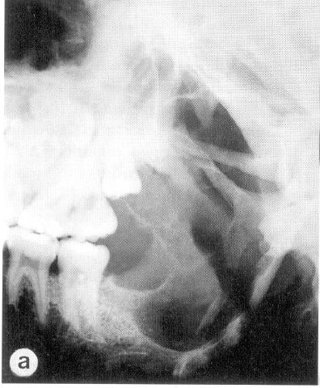
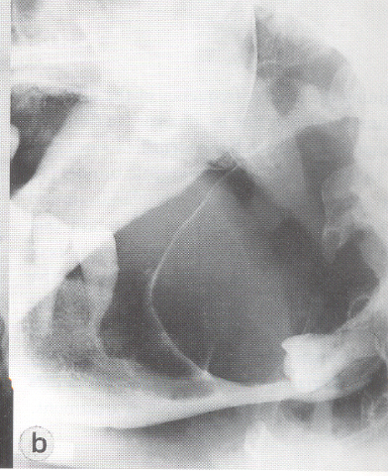
RADIOGRAPHIC FEATURES
Depends on nature of local bone reaction.
Classically multilocular radiolucency termed Soap bubble or Honey- comb appearance.
Growth within medullary cavity causing scalloping of inner cortex by pressure erosion.
Classification :
Multilocular- Multicystic
Unilocular
Septate- Trabeculated
Solid Type
Root resorption more frequent than displacement of teeth.

Slide 16
HISTOPATHOLOGY
Gross pathology
Cystic & solid areas
Cystic areas
Shiny,grayish membrane
Yellowish,thick fluid
Solid areas - fibroma

Slide 17
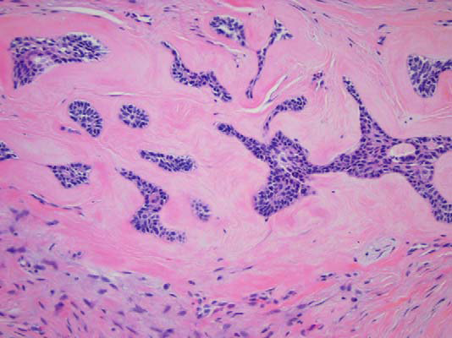
HISTOPATHOLOGY
Vickers and Gorlin in 1970
(1) The nature of the background stroma of the tumor
(2) Growth pattern of the epithelium that makes up the tumor
(3) Staining pattern of the neoplastic cells
(4) Cellular morphology
(5) Nuclear orientation

Slide 18
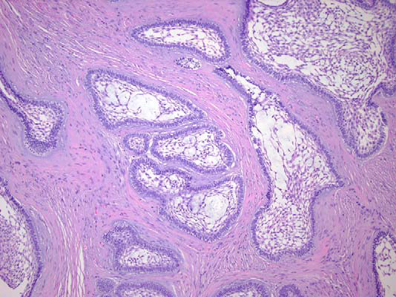
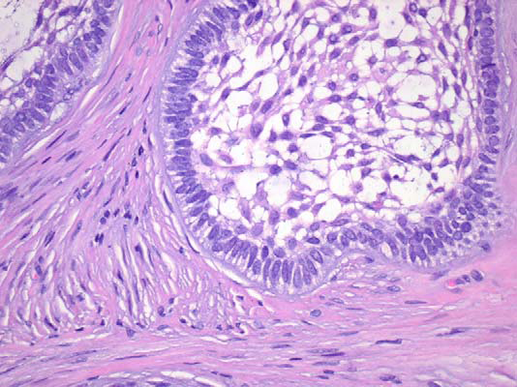
HISTOPATHOLOGY
Nests of interlacing cords of cells within a fibrous stroma
In centre of each nests of cells lies a loose network of cells showing signs of cystic degeneration
At the periphery of these nests lie cells resembling IEE
These cells exhibit reverse polarity

Slide 19
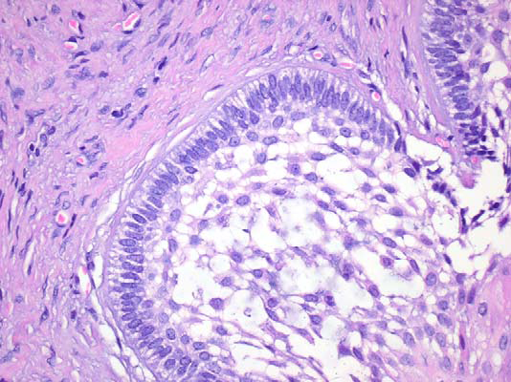
HISTOPATHOLOGY- sub types
Follicular ameloblastoma.
An island of tumor cells simulates enamel organ formation at the bud stage of odontogenesis.
Central cystic degeneration – microcystic pattern
Recurrence rate – 29.5 %

Slide 20
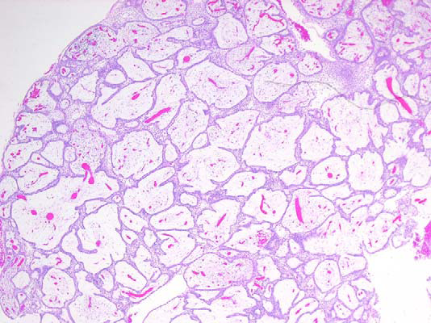
HISTOPATHOLOGY- sub types
Plexiform ameloblastoma :
When neoplastic cells occasionally devolop into a network of epithelium
Recurrence rate – 16.7 %

Slide 21
HISTOPATHOLOGY- sub types
Acanthomatous ameloblastoma.
Parakeratinization of the central cells in the tumor islands is present.
This effect produces a characteristic pink color to the center of the
islands that contrasts the basophilic staining periphery
Recurrence rate – 4.5 %

Slide 22
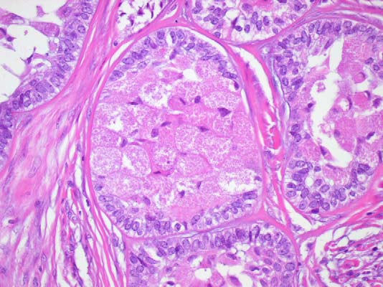
HISTOPATHOLOGY- sub types
Granular cell ameloblastoma.
A type of solid ameloblastoma in which central neoplastic cells exhibit prominent cytoplasmic granularity

Slide 23
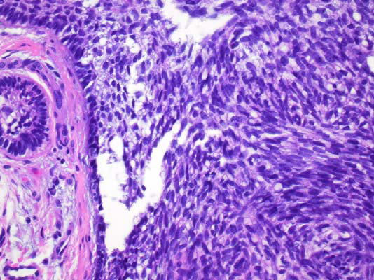
HISTOPATHOLOGY- sub types
Basal cell ameloblastoma.
There is an absence of stellate reticulum-like areas.
There is a marked resemblance to basal cell carcinoma

Slide 24
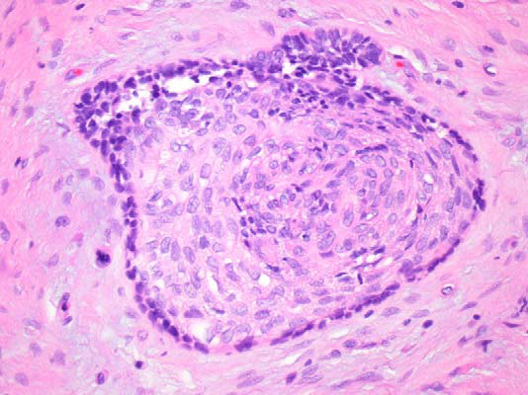
HISTOPATHOLOGY- sub types
Desmoplastic ameloblastoma.
The stroma is desmoplastic & tumour islands become squamoid or elongated .

Slide 25
UNICYSTIC AMELOBLASTOMA
10 to 15% of all intraosseous ameloblastoma
Originates de nova or neoplastic transformation of non neoplastic cyst epithelium.
A high percentage of these lesions are associated with an impacted tooth, and the most commonly cited provisional diagnosis is dentigerous cyst.
Often seen in younger patients
Depending on the stage of devlopment – 3 types

Slide 26
UNICYSTIC AMELOBLASTOMA
Intraluminal ameloblastoma
The devoloping ameloblastoma is growing into the lumen & has not violated the wall of the cyst.
Mural ameloblastoma
The devoloping ameloblastoma is growing in the wall of a cyst & confined within the limits of the wall
Conservative surgical approach is often advocated

Slide 27
UNICYSTIC AMELOBLASTOMA
Invasive ameloblastoma
When the tumor has extended beyond the wall of a cyst & into the adjacent bone or soft tissue or when the neoplasm develops from the epithelium other than the cystic epithelium.
Radical approach is advocated.

Slide 28
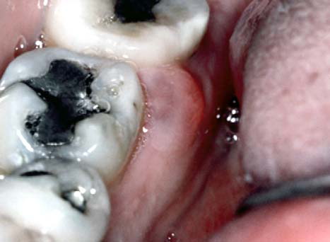
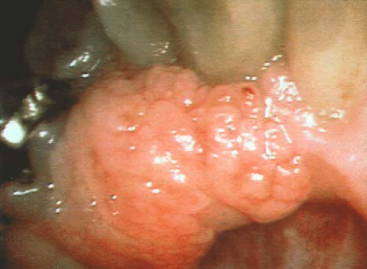
Extra osseous ameloblastoma
Develops entirely outside the bone.
Etiology
Dental lamina or
From basal cells of oral epithelium or
From cells that have undergone SMITH 1968 differentiation to mimic the ameloblast
Nodular swelling within the soft tissues adjacent to mandible or maxilla
Slow growing lesion.

Slide 29
Surgical considerations
The maxillary ameloblastoma is not confined by the strong cortical plate found in the mandible. In addition, the posterior maxilla lies in close relationship to many vital structures.
In the mandible, 1-cm clear margins are considered the standard.
For peripheral ameloblastoma, a more conservative excision with close clinical follow-up is the standard of care.

Slide 30
Treatment
High recurrence rate , controversy, individual surgeon’s philosophy
Curettage: Removal of tumour by scraping from surrounding normal tissue.
Least desirable.
90% recur(Sehdev 1974).
More severe in maxilla. Nests of tumour extend much beyond clinical and radiological margin.

Slide 31
En Bloc resection
Kramer 1963,
Diffuse invasion of cancellous marrow but not haversian system of compact bone
compact bone of mandible is eroded but not invaded.
Removal with rim of uninvolved bone, maintaining continuity.
1-2 cm safe margin.
Mandible -no recurrence (Sehdev 1974).
Maxilla- not successful (Bjorklund1979, Chaudhuri 1975)

Slide 32
Segmental resection
Most commonly used- hemimaxillectomy/hemimandibulectomy
Mehlisch- 33% recurrence in tumours of diameter more than 5cms
Sehdev- 21%

Slide 33
Other modalities
Cautery: desiccation / electrocoagulation, secondary ischemia and necrosis for some distence. Mehlisch, Dahlin (1972)-50% recur.
Carbon di-oxide laser
Cryosurgery

Slide 34
PINDBORG’S TUMOR (CEOT)
Uncommon, benign, odontogenic neoplasm that is exclusively epithelial in its tissue of origin
Pindborg 1958
Arises from REE, based on the close proximity of the tumour to embeded or unerupted teeth
Gon 1965
In instances of retained teeth, the REE fails to fuse with the oral epithelium, which then may possibly result in abnormal proliferation of stratum intermedium in an attempt to carry out its function
Intra osseous & Extra osseous variants

Slide 35
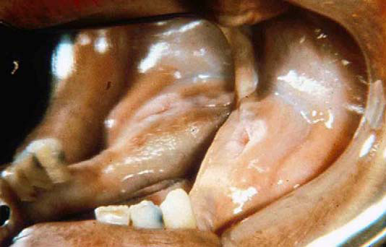
Clinical Features
Expansile slow growing mass with a rather slow growing rate
No age / sex predliction
Mandibular molar/premolar region
All intra osseous CEOT of maxilla- posterior region
Associated with an unerupted or impacted tooth

Slide 36
Radiographic findings
Unilocular radiolucent lesion which may progress to multilocular lesion with minute calcified masses
Chaudhry 1972 – 3 stages
Similar & cannot be differentiated from dentigerous cyst
Minute calcifications appear [ dentigerous cyst / cystic odontoma ? ]
Honeycomb appearance – bone destruction& calcium deposition

Slide 37
Histologic characteristics
Epitheloid strands/nests/sheets
Amyloid & calcifications
Rare clear cell variant
Differential diagnosis :
Dentigerous cyst
OKC
AOT
Marginal segmental resection
Recurrence potential < 20%

Slide 38
CENTRAL ODONTOGENIC FIBROMA
WHO : "As a fibroblastic neoplasm containing variable amounts of apparently inactive odontogenic epithelium"
Relatively rare,< 10% of all odontogenic tumors
Origin - Dental follicle – associated with unerupted teeth Periodontal ligament – not associated with unerupted teeth.
Females ,wide age range (mean, 37 years).
Mandible ,anterior portions of the jaws.
Its association with impacted teeth is uncommon.

Slide 39
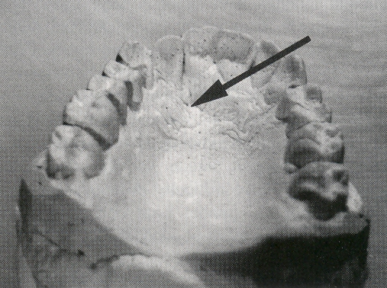
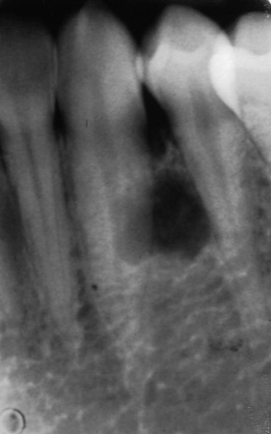
CENTRAL ODONTOGENIC FIBROMA
The unique presence of a palatal cleft when combined with the characteristic radiographic finding is highly suggestive of a codf.
Radiographically: well demarcated unilocular radiolucencies, but multilocular and mixed-density lesions can occur.
Locally aggressive,but tend to be separated from surrounding bone.

Slide 40
CENTRAL ODONTOGENIC FIBROMA
Histolopathologic features
(1) Fibrous tissue of variable cellularity and density;
(2) Variable amounts of inactive-appearing odontogenic epithelium; and
(3) Variable presence of calcifications resembling dysplastic dentin, cementum-like tissue, or bone
Enucleation followed by thorough curettage, unless the clinical behavior is unusually aggressive
The recurrence rate - 26%

Slide 41
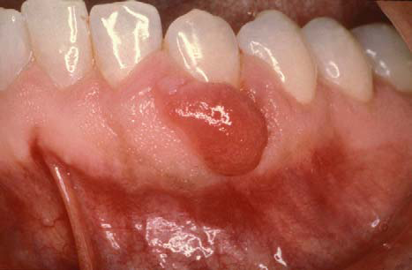
PERIPHERAL ODONTOGENIC FIBROMA
Gingival counterpart of the COdF
Ectomesenchymal in origin
Rare , 1.2 %
Gingival or alveolar ridge tumor
Histolopathologic features
unencapsulated proliferation of cellular fibrous or fibromyxomatous connective tissue that exhibits variable amounts of odontogenic epithelium and sometimes foci of calcification in the form of dentinoid, cementicles, or bone

Slide 42
Myxoma
(odontogenic myxoma,fibromyxoma)
WHO :"As a locally invasive neoplasm consisting of rounded and angular cells that lie in an abundant mucoid stroma".
Myxomas of the facial skeleton can be derived from primordial odontogenic mesenchyme or from nonodontogenic (osteogenic) embryonic connective tissue.
<40 years, males.
2:1 for mandible, molar & premolar regions
Painless expansion of the involved bone – growth may be rapid – due to accumulation of myxoid ground substance

Slide 43
Myxoma
(odontogenic myxoma, fibromyxoma
Radiographic features:multilocular radiolucencies with characteristic soap-bubble or wispy pattern.
Cortical expansion or perforation & root displacement or resorption
Histolopathologic features
Bland myxoid
No epithelial rests
Variable amounts of collagen

Slide 44
Myxoma (odontogenic myxoma, fibromyxoma
Complete surgical removal by conservative treatment can be difficult to achieve because the myxoma readily infiltrates the surrounding bone tissue without its immediate destruction.
There is a high recurrence rate after inadequate surgical treatment

Slide 45
CEMENTOBLASTOMA
Rare odontogenic tumour of C.T forming cementum like calcification, fused to a tooth root.
Due to abnormal periodontal membrane growth & devolopment
Teenage, no sex prediliction
Mandibular-premolar & molar regions
Slow growth & lack of symptoms
Attached to vital tooth root
Expansion of buccal & lingual cortical plates
Occasionally , pain or parasthesia

Slide 46
CEMENTOBLASTOMA
R/f- mottled or radiopaque mass attached to a tooth root rimmed by radioplucent halo.
H/f-
Encapsulated mass of osteocementum entrapping fibrous tissue
Surrounding tooth root – sleeve
Separate area of cementogenisis may be seen
Enucleation

Slide 47
AMELOBLASTIC FIBROMA
True mixed tumor arising from a combination of 2 embryonic tissues
The epithelial component is able to induce mesenchyme but not to the extent of developing dental hard tissues
Relatively uncommon tumor of young people (aged 5-20 y)
75% -posterior mandible in the area of a developing tooth
It is benign and expansile, growing as a pushing front rather than invading surrounding tissues.

Slide 48
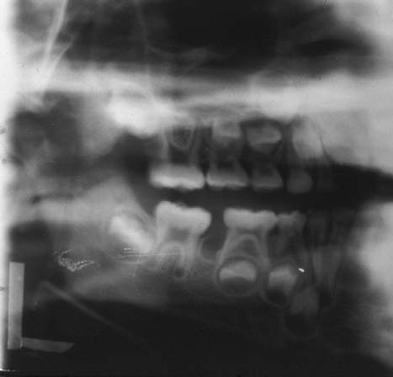
AMELOBLASTIC FIBROMA
Uniocular or bilocular radiolucency-posterior mandible
H/F : composed of neoplastic epithelium & neoplastic myxomatous connective tissue
Block excision with a border of normal bone
Recurrence rate- 20-40%
Sarcomatous change (ameloblastic fibrosarcoma) also has been reported with recurrence or inadequate excision

Slide 49
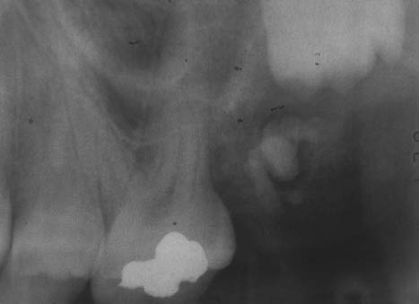
Ameloblastic Fibro-odontoma
WHO : " A neoplasm having general features of an ameloblastic fibroma while containing dentin & enamel".
Abnormal proliferation of odontogenic epithelium from a permanent tooth germ.
Expansile lesion, slow growth, attains large sizes.
Swelling and mild pain, Altered occlusion, delayed eruption of teeth.
X-ray shows radiopaque material in a well circumscribed radiolucency, smooth and even border.
Aggressive and invades adjacent tissues
Wide radical excision

Slide 50
ODONTOMAS
Broca 1866 -odontome
Thoma & Goldman –odontoma
"Benign tumors of dental hard tissues with the word 'composite' used to designate the presence of the four dental tissues.
Anywhere in the jaws, frequent in third molar and incisor-canine region.

Slide 51
COMPOUND-COMPOSITE ODONTOMA
Odontomas with calcified structures & some degree of anatomical resemblence to normal teeth
Hopper 1970
Enamel organ or dental lamina in place of a normal tooth or from supernumerary lamina in association with follicle of unerupted tooth.
Hitchin 1971
Inherited or mutant gene or interference in post natal tooth devolopment
Maxillary incisor – canine region
2nd -3rd decade

Slide 52
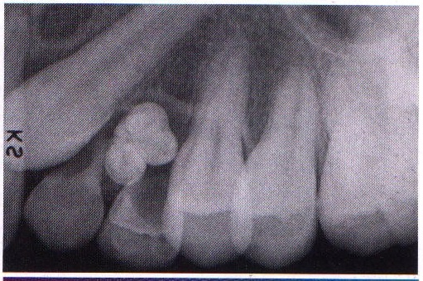
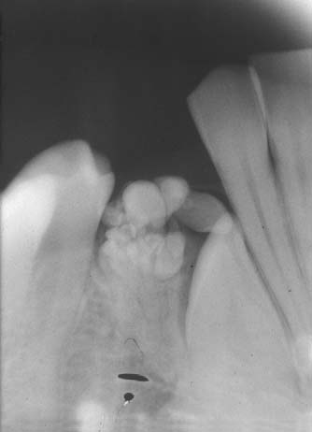
COMPOUND-COMPOSITE ODONTOMA
Slow growing, noninfiltrating, nonaggressive self limiting
Most common cause for failure of permanent tooth eruption
Enucleation if capsule intact
May recur if removed during soft tissue stage

Slide 53
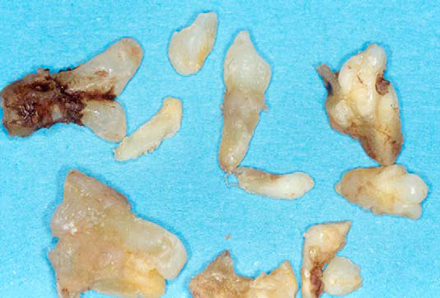
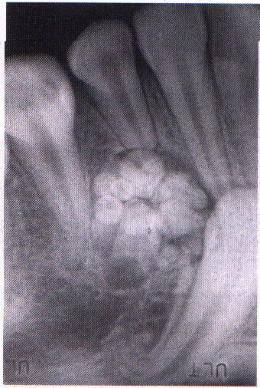
COMPLEX-COMPOSITE ODONTOMA
Abortive attempt at tooth formation
Poor structural differentiation & disorderly arranged calcific masses
Little resemblence to normal teeth
2nd -3rd decade
2nd -3rd molars region
Less common, small lesion
Enucleation & curettage
May undergo cystic transformation

Slide 54
BENIGN NON ODONTOGENIC TUMOURS

Slide 55
EPITHELIAL TUMORS
SQUAMOUS EPI | Sq. cell papilloma | SCC/ epidermoid ca
BASAL CELL LAYER | ----- | Basal cell ca
NEURO- ECTODERM | Nevus | Melanoma
TRANSITIONAL EPI | Transitional cell papilloma | Transitional cell ca
GLANDULAR EPI | Adenoma | adenocarcinoma
HEPATOCYTES | Liver cell adenoma | Hepatoma

Slide 56
NON-EPI/ MESENCHYMAL TUMORS
ADIPOSE TISSUE | Lipoma | Liposarcoma
ADULT FIBROUS TISSUE | Fibroma | Fibrosarcoma
EMBRYONIC FIB TISSUE | Myxoma | Myxosarcoma
CARTILAGE | Chondroma | chondrosarcoma
BONE | Osteoma | Osteosarcoma
SMOOTH MUSCLE | Leiomyoma | Leiomyosarcoma
SKELETAL MUSCLE | rhabdomyoma | rhabdomyosarcoma

Slide 57
BLOOD VESSLE | Hemangioma | Angiosarcoma
LYMPH VESSLE | Lymphangioma | Lymphangiosarcoma
HAEMATOPOITIC CELLS | -------- | Leukemias
NERVE SHEATH | Neurilemmoma Neurofibroma | Neurogenic sarcoma
SYNOVIUM | Benign synovioma | Synovial sarcoma
MESOTHELIUM | -------- | Mesothelioma
LYMPHOID TISSUE | Pseudolymphoma | Malignant lymphoma

Slide 58
MIXED TUMORS
SALIVARY GLAND | Pleomorphic adenoma | Malignant mixed salivary tumor
Tumors of more than 1 germ cell layer
Totipotent cells in gonads or embryonal rests | Mature teratoma | Immature teratoma

Slide 59
TUMOURS OF EPITHELIAL ORIGIN
PAPILLOMA
Common neoplasm ----- from surface epithelium
Similar to that of fibroma
Clinical features :
Exophytic growth --- small finger like projections.
Roughened, verrucous or “cauliflower like” surface.
Well circumscribed pedunculated / sessile.

Slide 60
Tongue, lips, buccal mucosa, gingiva and palate
Few mm --- several cm.
Any age
M= F
Common wart --- skin analogous to oral papilloma.
Auto inoculation by finger sucking or fingernail biting.

Slide 61
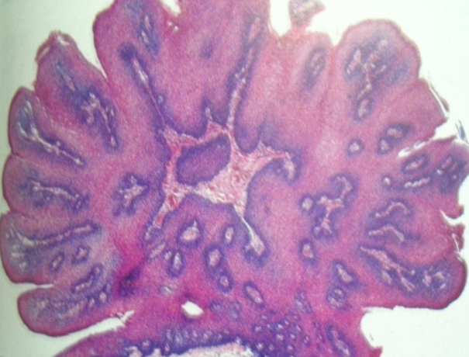
H/P
Rx
Excision--- with pedicle / stalk
Recurrence is rare
Malignant degeneration -- unlikely

Slide 62
NAEVUS
(Pigmented mole, Benign melanocytic nevus)
ORIGIN- cells migrating from NCC to epithelium/dermis or from altered resident melanocytes
Types of nevi
Congenital
Acquired.

Slide 63
I/O nevi
Rare
Occur at any age
Small elevated papules/nodules
<0.5 cm
Palate common site
Other– buccal/labial mucosa, gingiva, alv ridge, vermillion

Slide 64
H/P
Junctional nevus
Compound nevus
Intradermal nevus (common mole)
Blue nevus.

Slide 65
D/D
Amalgam tattoo
Melanoma
Hematoma
Kaposi’s sarcoma
Hemangioma
Rx
Excisional biopsy
Recurrence unlikely
Malig. Trans… melanoma... rare

Slide 66
NON EPITHELIAL (MESENCHYMAL)
LIPOMA
Tumor of mature adi. Tiss.
Most common mesenchymal Tumor
H& N lipoma… 13 % of all lipoma
Pathogenesis uncertain➔ common in obese
C/F
40 yrs/ >
F> M
Buccal mucosa, vestibule common site
< in tongue, floor of mouth, lips

Slide 67
Asymptomatic
3 cm/ >
smooth nodular masses
Sessile/ pedunculated
Yellow hue
Soft, fluid like

Slide 68
Variants of lipoma
Fibrolipoma
Fibrous+
Fat cells
Angiolipoma
Blood ves
+fat cells
Myxoid
Mucoid+ fat
Spindle
Spindle cell
+fat
Intramuscu
lar

Slide 69
H/P
Well circumscribed--- thin fibrous capsule
Lobular arrangement of cells
TREATMENT
Local excision
Recurrence – 5%

Slide 70
FIBROMA
Irritation fibroma, traumatic fibroma, fibrous nodule
Most Common tumor of oral cavity
Reactive hyperplasia of fibrous CT➔ local irritation
C/F
4- 6 decade
M- F 1:2
Buccal Mucosa..Along bite line--- cheek bite
Labial mucosa, tongue, gingiva

Slide 71
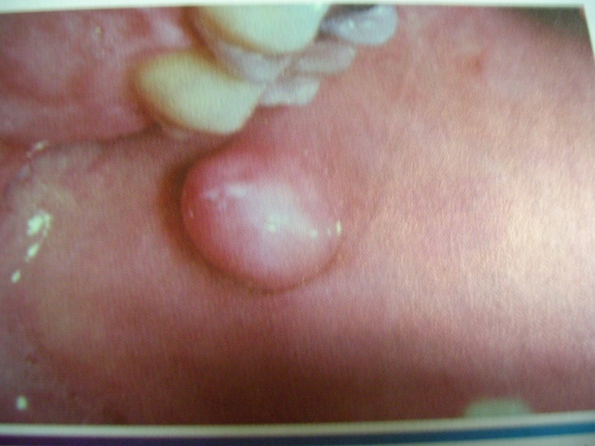
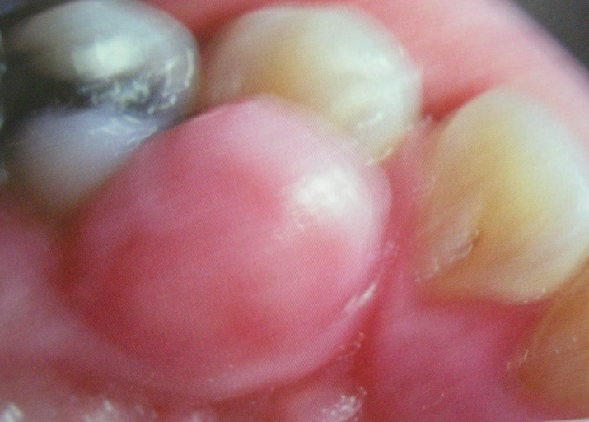
Smooth surfaced pink nodule
White surface --- hyperkeratosis ➔ irritation
Sessile, some pedunculated
Mm- cm
Asymptomatic until ulceration of surface

Slide 72
H/P
Mass of fibrous con.tissue covered by str. Sq. epi
Con tissue dense and collagenised
Collagen bundles arranged in radiating, circular, haphazard pattern

Slide 73
Epi– atrophy of rete ridges( fibrous mass)
Scattered infl---- lymphocytes and plasma cells
TREATMENT
Excision
H/P evaluation– rule out malignancy
Recurrence - rare

Slide 74
CHONDROMA
Rare tumor
originating from meckel's cartilage within the mandible or from cartilaginous rests
Trauma from dentures – inducing agent
Slow growing but locally invasive
Extra osseous chondroma
6th decade
M=f
Lateral margin of tongue
Firm nontender nodules beneath an intact mucosa

Slide 75
Intra osseous chondroma
3rd -4th decade
Mandible-posterior to lower cuspid or within coronoid or condylar process
Body of mandible- swelling & loosening of teeth
Coronoid or condyle- swelling in region of zygoma, malocclusion or limitation of mandibular movement
R/f: well defined or extensive destruction of bone with root resorption
H/f: greyish masses with bluish cartilagenous areas intermixed with cystic spaces
Radical excision with wide cuff of normal tissue
Multiple recurrences - malignant

Slide 76
OSTEOMA
Benign tumor containing mature compact/cancellous bone
True neoplasm/ bone response to stimuli
Restricted to craniofacial skeleton
C/F & radiologic features
Young adults
Asymptomatic, solitary lesions
cranial bones > facial bones
Body of mandible/ condyle--- common area
Most occur post to premolars on lingual surface

Slide 77
Types
Periosteal osteomas
Slow growing mass on surface of mand/max
Polypoid/ sessile mass
Some--↑ size➔ facial deformity
Cosmetic reconturing
Endosteal osteomas
In medullary bone
Small – asymptomatic
Large– enlargement of affected area
Periodic observation

Slide 78
Condylar osteoma
Osteoma-→ mand condyle
Shift in occlusion
Shift in midline
Facial swelling ,pain, limited mouth opening
Lobulated growth (hyperplasia– condyle normal shape)
Surgical excision

Slide 79
H/P
Compact osteomas– normal appearing dense bone with minimal marrow tissue
Cancellous--- trabecular bone+ fibrofatty tissue
Osteoblastic activity

Slide 80
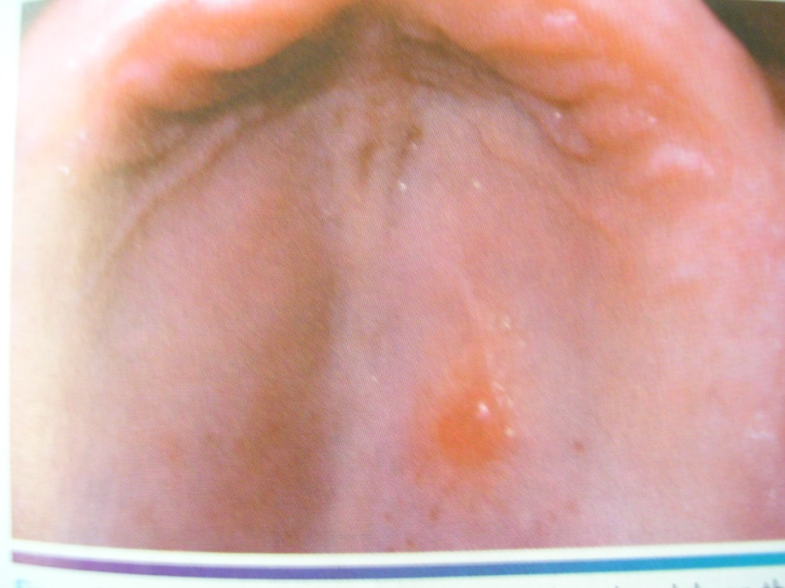
LEIOMYOMA
Benign neoplasm of smooth muscles in uterus, GIT, skin
3 types
Solid
Vascular - common in oral cavity
Epithelioid
C/F
Any age
Slow growing firm mucosal nodule
Asymptomatic
Lips, tongue, palate, cheek--- 80%
Intraosseous – rare, Unilocular radiolucencies

Slide 81
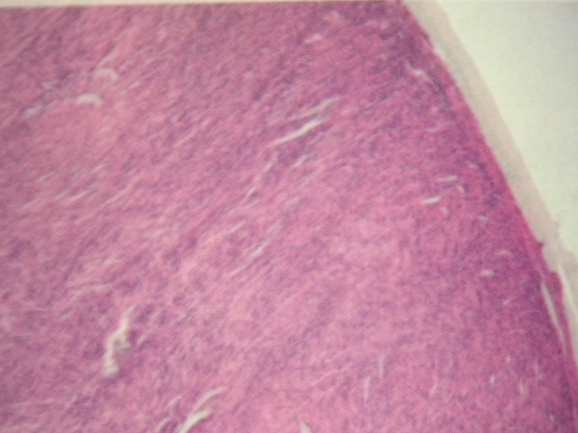
H/p
Well circumscribed with interlacing bundles of smooth muscle cells
Nuclei– elongated, pale staining, blunt ended
TREATMENT
Surgical excision
No recurrence

Slide 82
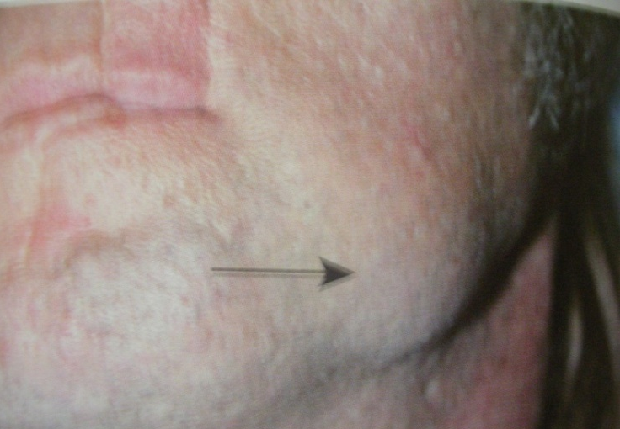
RHABDOMYOMA
Neoplasm of skeletal muscle.
H & N
Adult
Fetal
C/F
Adult type- Middle age & older pt
70% in men
Pharynx, oral cavity, larynx
I/O– FOM, soft palate, base of tongue
Nodule/ mass.. Grows to many cm
Multinodular or multicentric also
Fetal – children in face & preauricular region

Slide 83
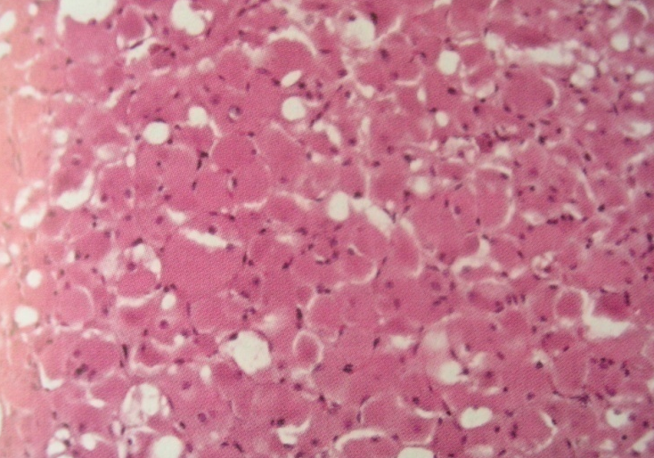
H/P
Well circumscribed lobules of large polygonal cells with abundant granular, eosinophilic cytoplasm
Peripheral vacuolization➔ spider web
TREATMENT
Surgical excision

Slide 84
HEMANGIOMA
Developmental vascular anomaly
Benign tumor of infancy
Rapid growth phase--- endothelial cell proliferation.
Gradual involution
Recognized during 1st 8 weeks of life

Slide 85
Classification
Type of vessel involved
Capillary
Venous
Arterial
Hemodynamic features
low flow
High flow

Slide 86
C/F
5-10%-- in 1 yr old
F:M 3:1
H & N---- 60%
At birth– pale macule on skin
1st few weeks rapid development
Bright red color
Firm and rubbery to palpate
Compression– mass doesn’t regress
Deep lesion- slightly raised, bluish

Slide 87
Proliferative phase
6- 10 months
Involution phase
Less firm to palpate
Color change to dark
purple hue
Age 5– most of red color
disappears
Complete resolution by 5
Yrs age
90% resolving by age 9

Slide 88
Complications
20% of hemangioma
Ulceration with/ without sec infection
Hemorrhage
Pt with multiple cutaneous hemangioma ---- ↑ risk of visceral hemangioma
Tumors in neck– airway obstruction

Slide 89
LYMPHANGIOMA
Benign, hamartoma– lymphatic vessel
Dev malformation from sequestered lymph tissue that do not communicate with rest of lymphatic system
3 types
Lymphangioma simplex ( capillary lymphangioma)
Cavernous lymphangioma
Cystic lymphangioma/ hygroma

Slide 90
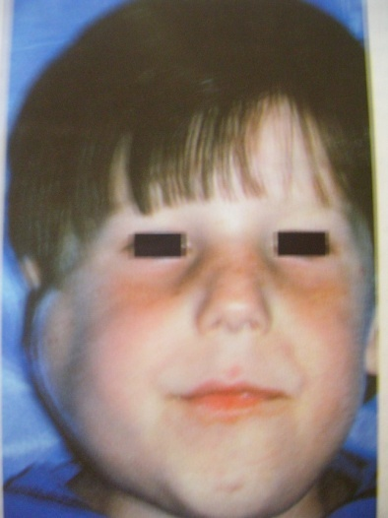
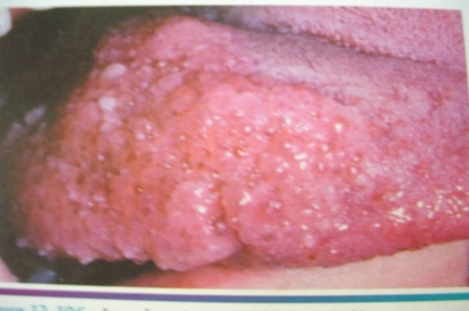
C/F
50- 70%-- H & N
50% Noted at birth,90% by 2 yrs of age
Cervical lymphangioma
Common --- post triangle
Soft fluctuant masses
Occasionally extend into mediastinum
Tumor enlargement– 2ry to URTI
Oral lymphangioma– ant 2/3 tongue ➔ macroglossia

Slide 91
MCGILL & MUILIKEN CLASSIFICATION
Type I
Developing below mylohyoid m.
Involving ant. & post. ∆
CT- Sharp cystic demarcations
Type II
Develop above mylohyoid m.
Involve tongue & lips
CT- poorly demarcated mass, obscured in fat & muscle tissues

Slide 92
H/P
Dilated lymphatic vessels or cyst like structures
Endothelium --- thin
Spaces – proteinaceous fluid
Lymphocytes
RBC

Slide 93
TREATMENT
Surgical excision
Choice- Type 1
Difficult – Type 2
Radiation , sclerosing agent – little effect
Recurrence rate – 5-10%

Slide 94
NEURILEMMOMA
Uncommon Neoplasm of schwann cell
25- 48%-- H & N
C/F
F>M
3-6th decade
Asymptomatic, pain & tenderness may present
Few mm- cm
Lateral neck, middle ear & pharynx
Tongue– common

Slide 95
Slow growing encapsulated
Arises from nerve trunk
Pushes nerve aside during growth
Within bone– expansion
H/P
Encapsulated tumor
2 microscopic patterns
ANTONI A
Fascicles of spindle shaped schwann cells
Palisaded arrangement around central acellular ,eosinophilic areas– VEROCAY BODIES

Slide 96
ANTONI B
Less cellular, less organised
Spindle cells randomly arranged within loose myxomatous stroma
TREATMENT
Surgical excision – maintaining neuronal integrity
Recurrence rare

Slide 97
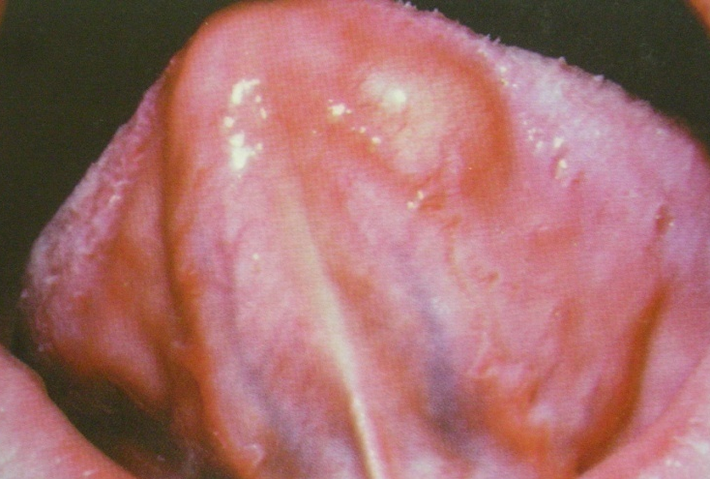
NEUROFIBROMA
Most common Peripheral nerve noeplasm
Origin- Mixed cell type
Schwann cell
Perineural fibroblasts
C/F
Solitary tumors in young adults
Slow growing, soft, painless lesions
Size– small nodule– large mass
Skin– common location

Slide 98
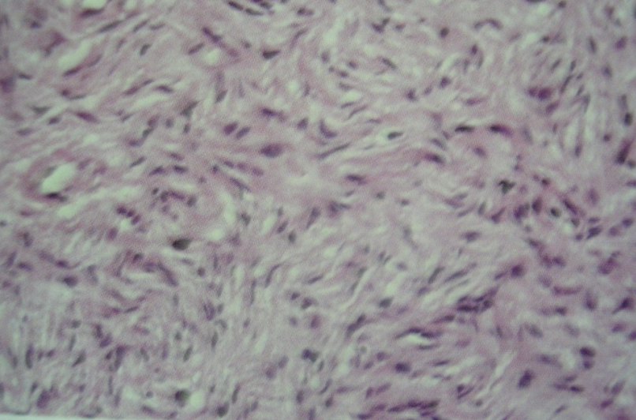
Tongue and buccal mucosa
Can arise within bone
Uni/ multilocular radiolucency
H/P
Well circumscribed
Tumor--- interlacing bundles of spindle shaped cells--- wavy nuclei
Delicate collagen bundles+ variable myxoid matrix
RX
Surgical excision
Recurrence is rare

Slide 99
REFERENCES
Oral and maxillofacial surgery– DANIEL M LASKIN
Oral and maxillofacial pathology– NEVILLE
Oral and maxillofacial pathology– MARX & STERN
oral pathology – clinical pathologic corelations-REGEZI
Text book of oral pathology– SHAFER
OMSCNA 2004
Contemporary Oral and maxillofacial pathology– SAPP
Surgical pathology- FONSECA
OCNA – 1986
Odontogenic Tumors and Allied lesions-RICHARDS &PHILLIPSEN

